Slide 1
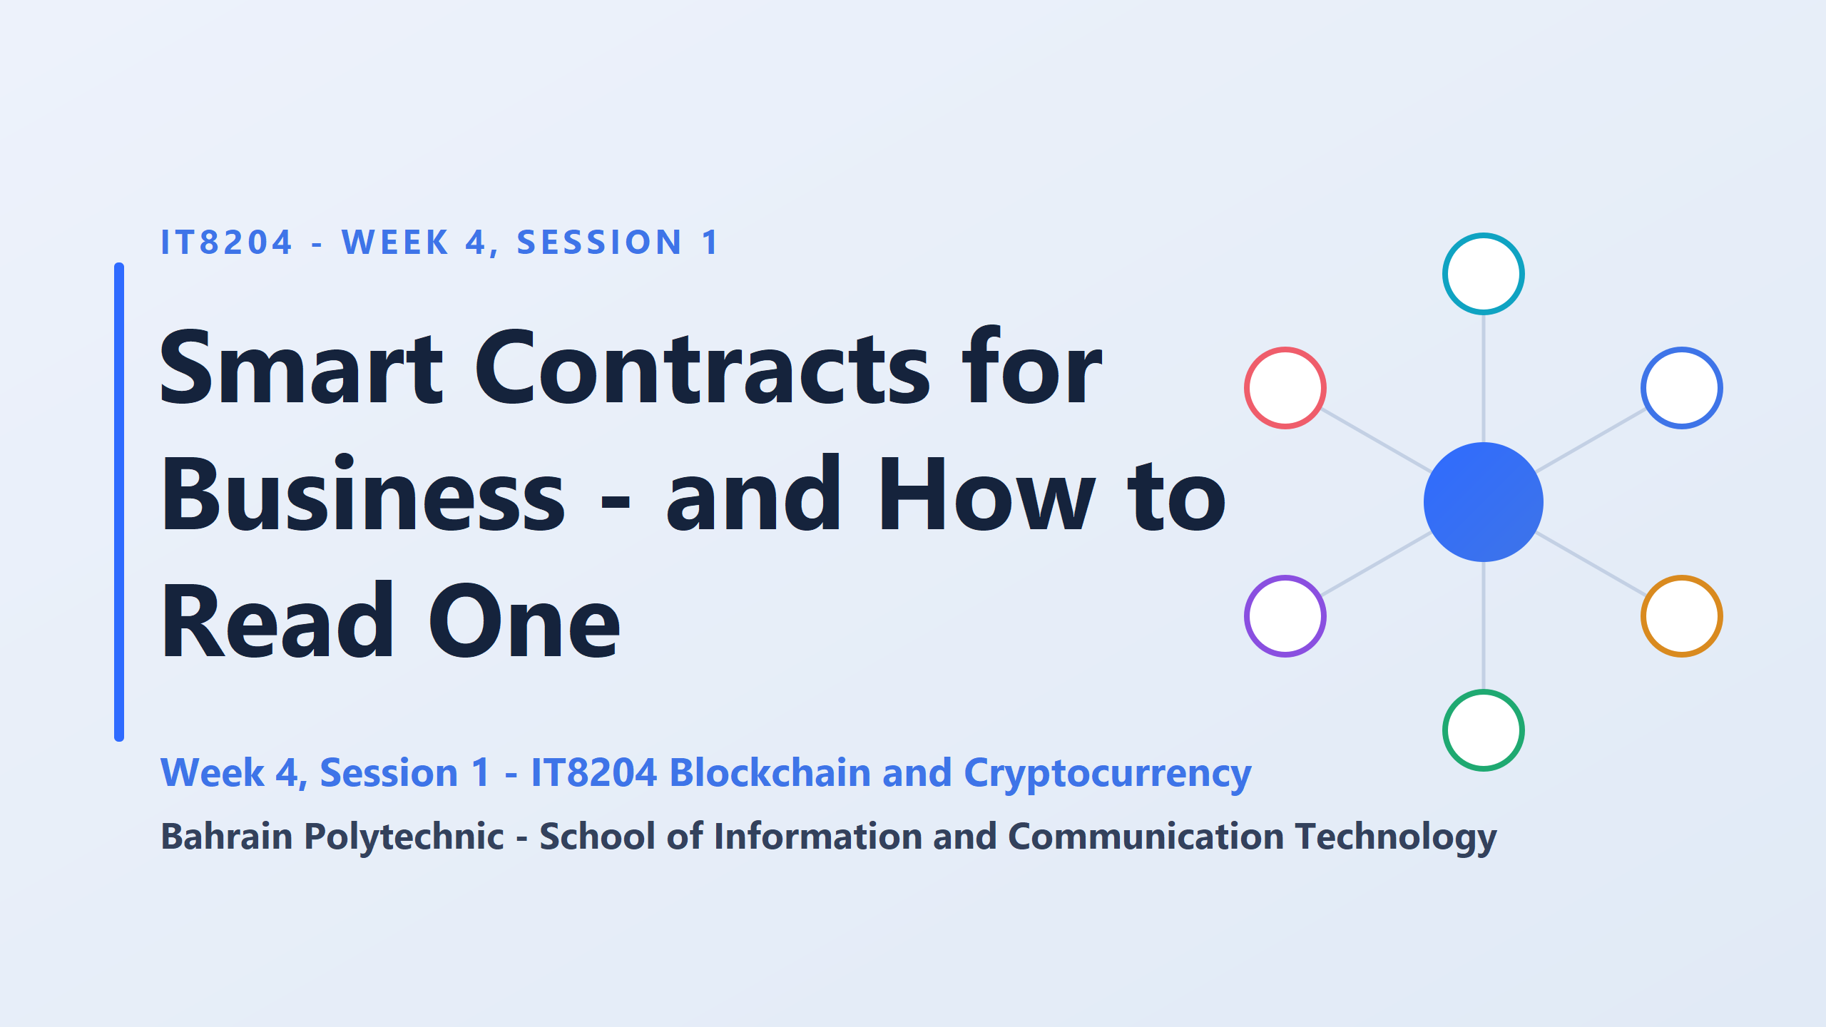
A smart contract is a small program stored on a blockchain. It runs by itself once its conditions are met

Slide 2
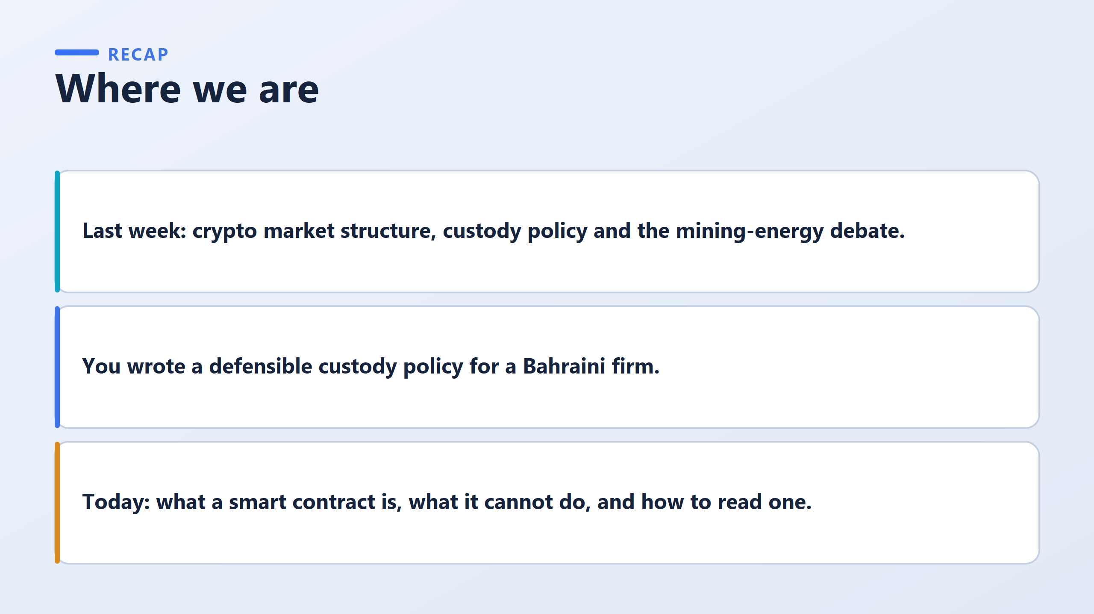

Slide 3
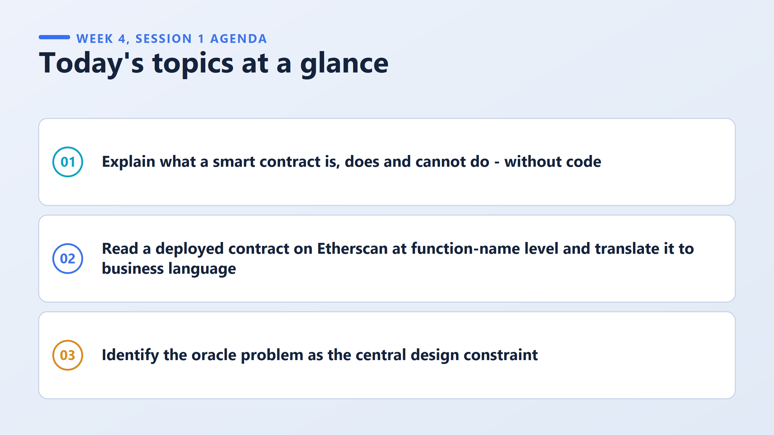
Deployed means the contract is already live on the blockchain.
Function-name level means students read only the names of the actions the contract can perform, not the code inside them.
Translate to business language means turning those names into plain business steps, such as "the contract lets the owner withdraw funds."

Slide 4
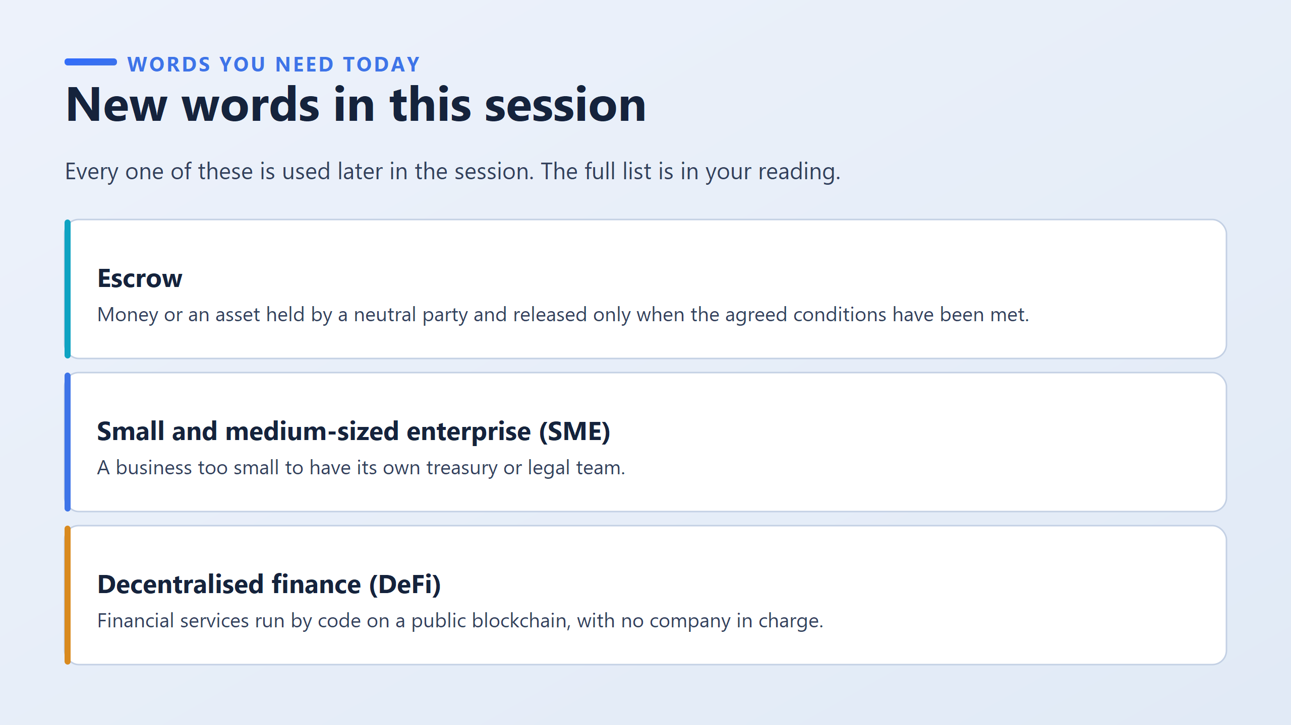
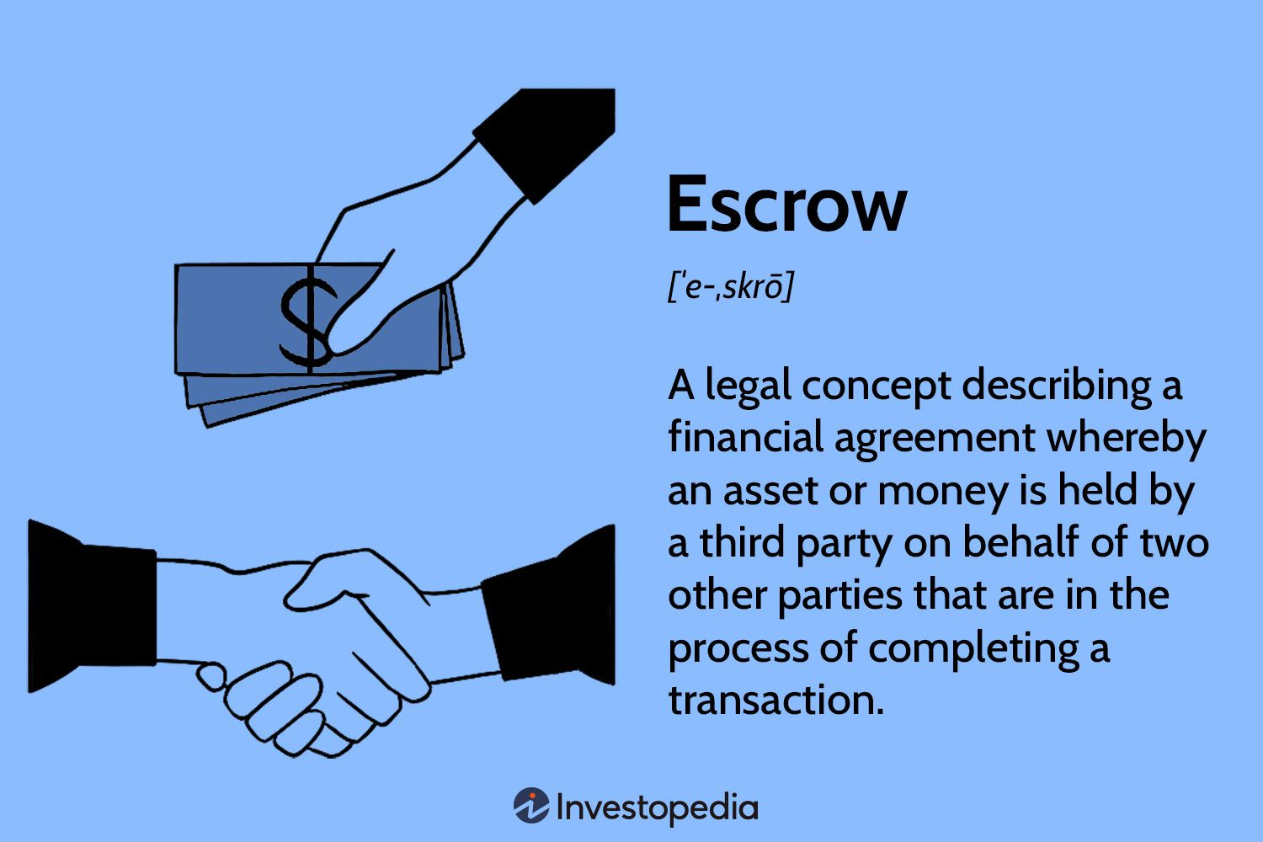

Slide 5
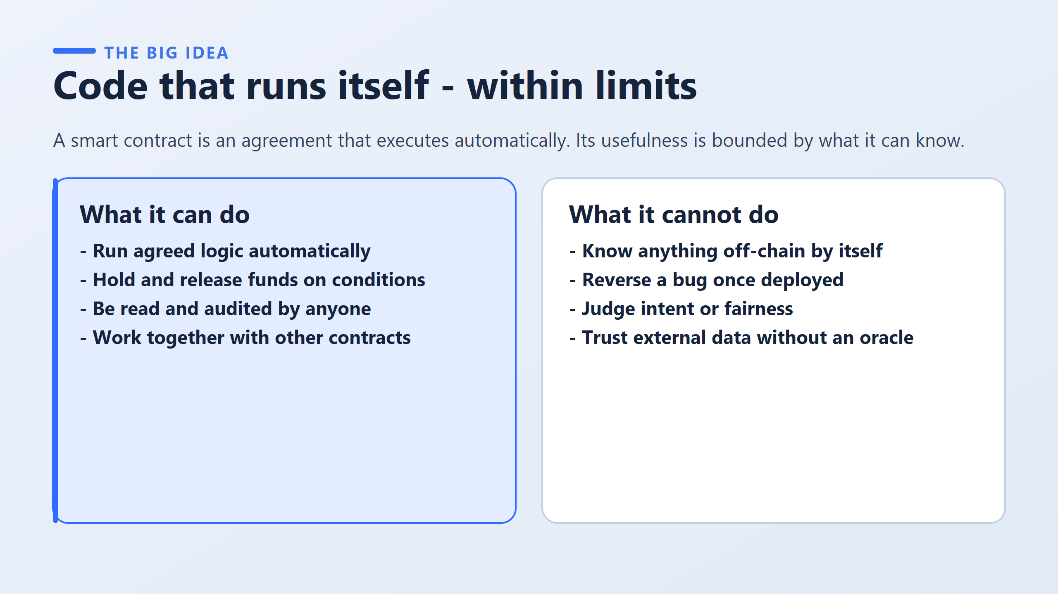
Know anything off-chain by itself: it cannot see the outside world.
Reverse a bug once deployed: it runs exactly as written, even if the writing was a mistake.
Judge intent or fairness: it checks a condition and does not weigh up a situation.
Trust external data without an oracle: outside facts only arrive through an oracle, and then you are trusting the oracle.
Run agreed logic automatically: it carries out the "if this, then that" rules without a person acting.
Hold and release funds on conditions: the money sits inside the contract and is released when the condition is met.
Be read and audited by anyone: the terms are public, so anyone can check them.
Work together with other contracts: one contract can use another, so services can be built on top of each other.

Slide 6
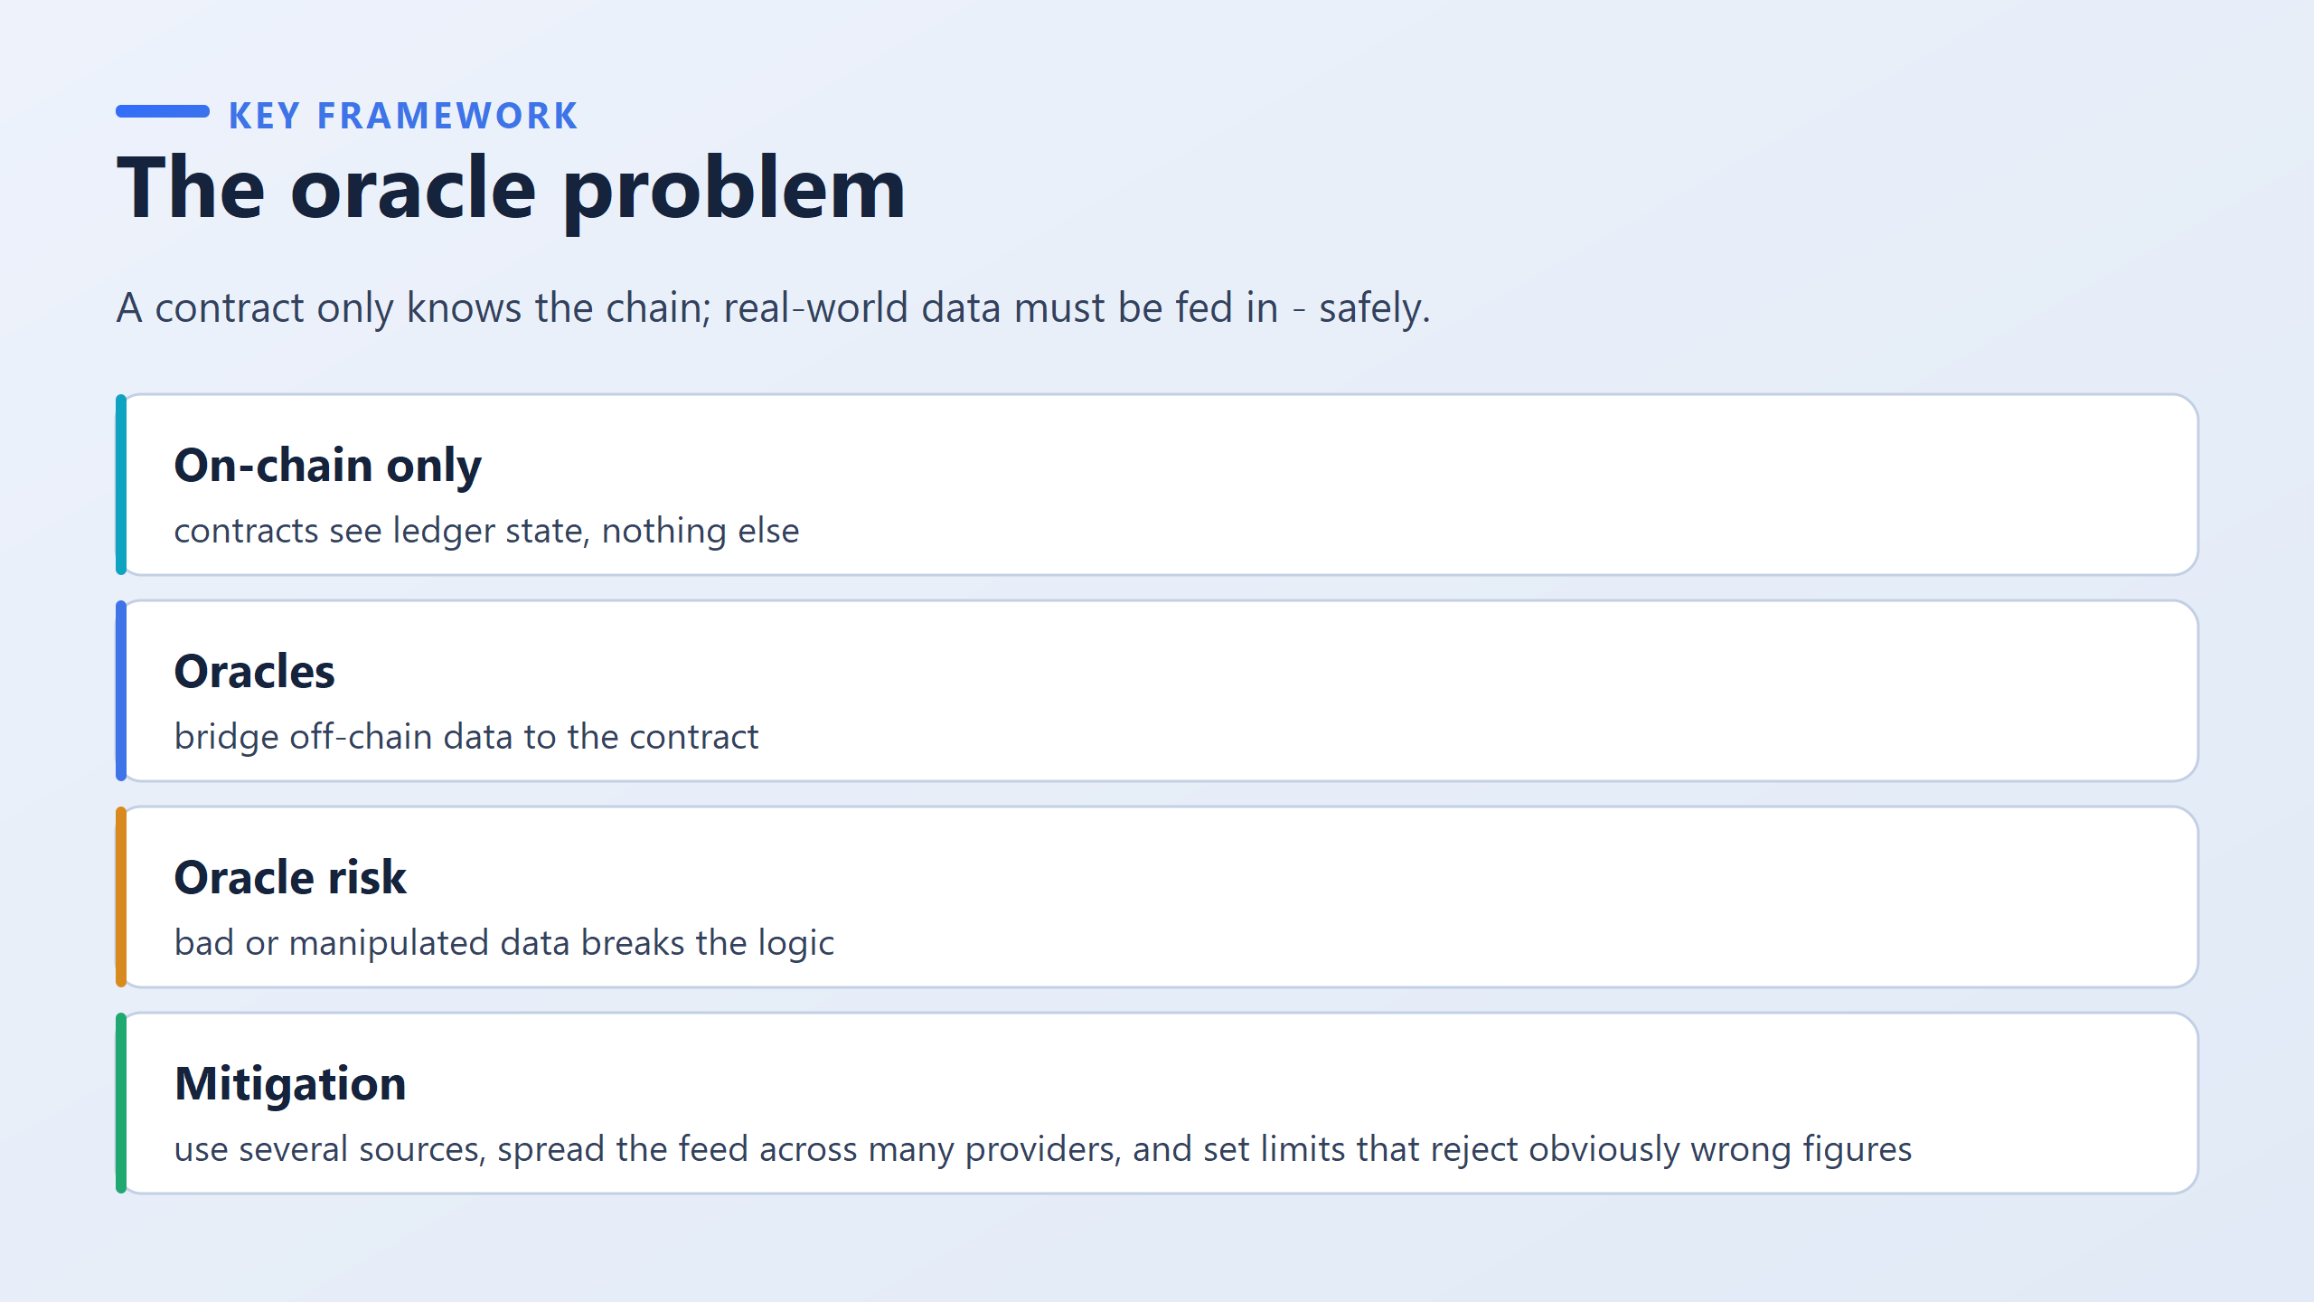

Slide 7
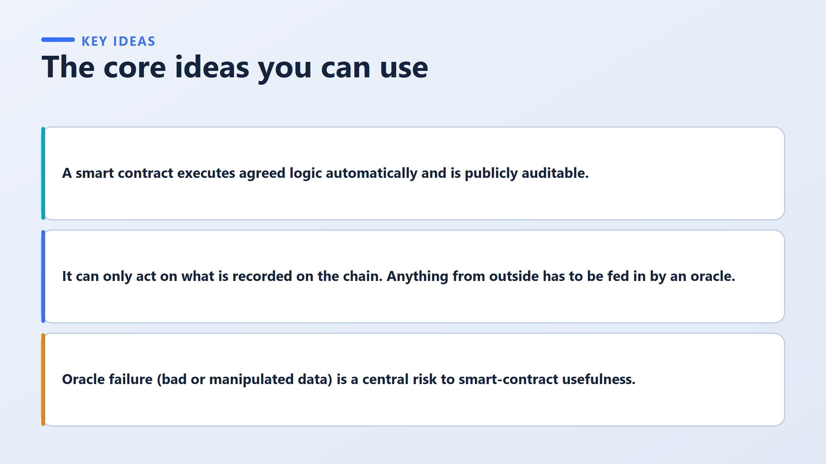

Slide 8
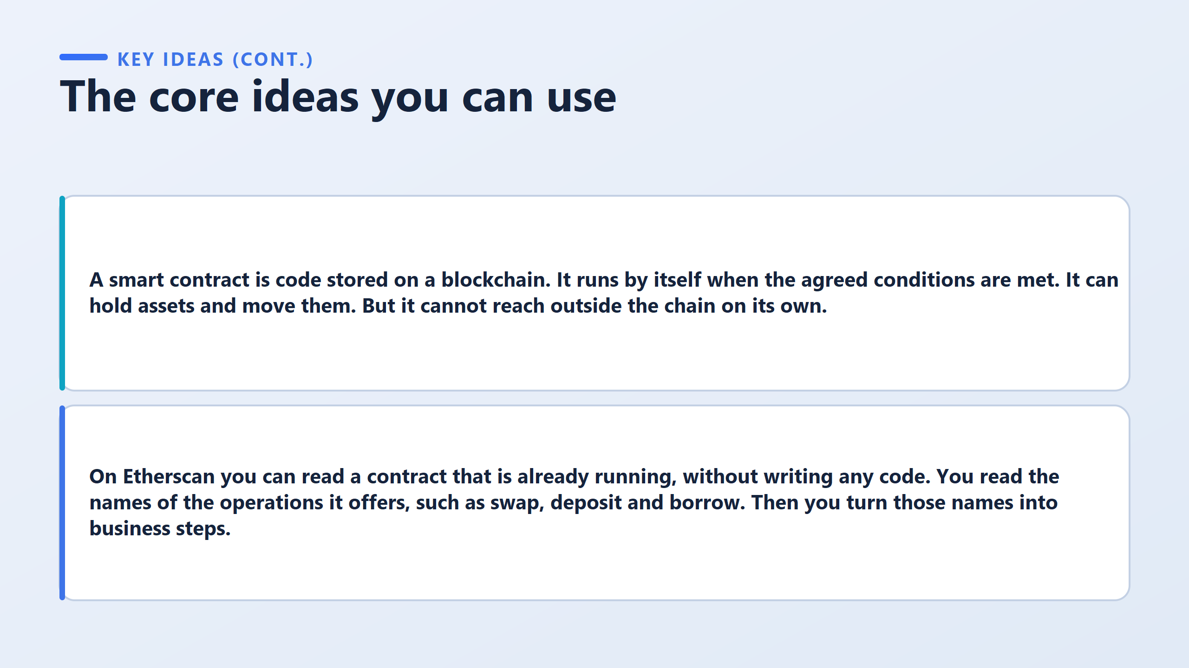

Slide 9
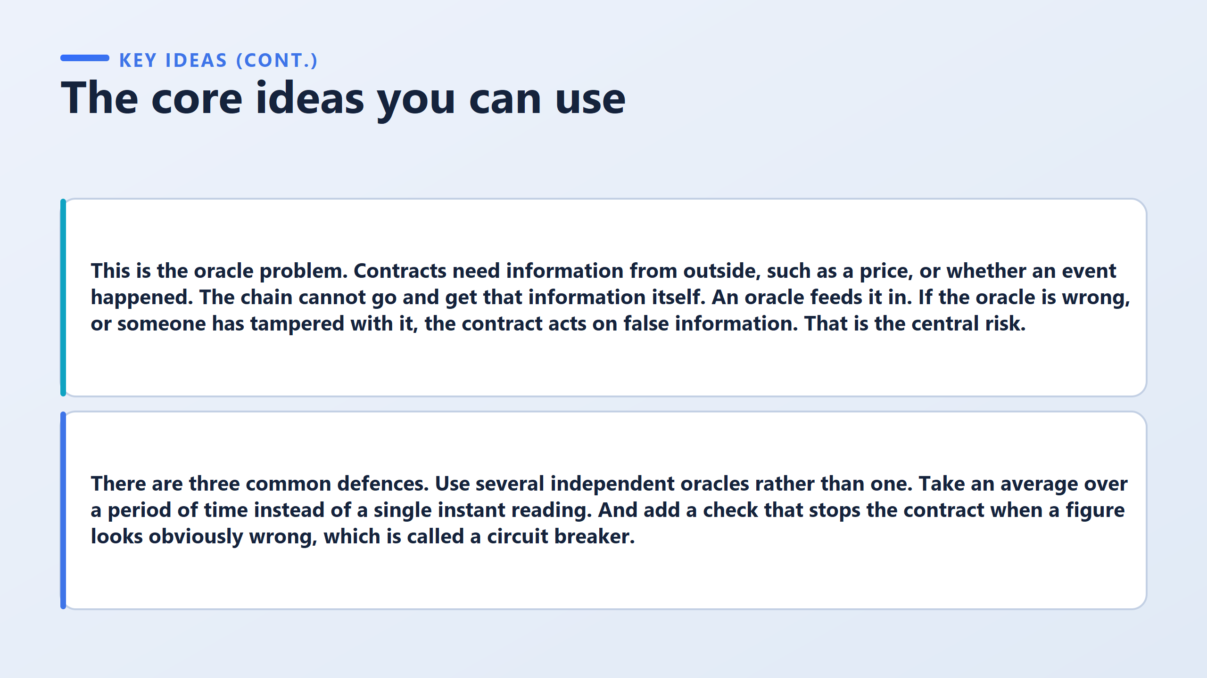

Slide 10
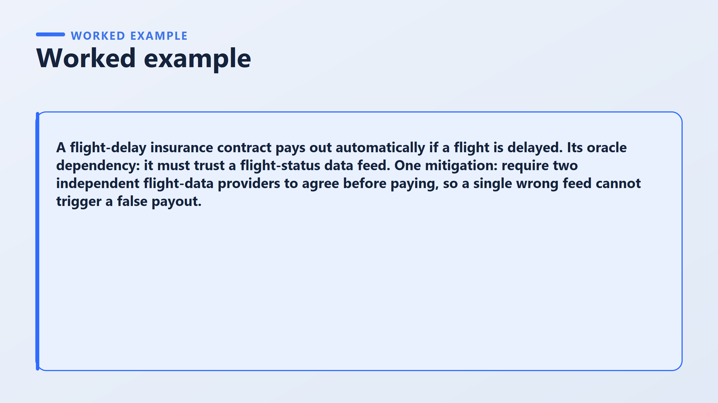

Slide 11
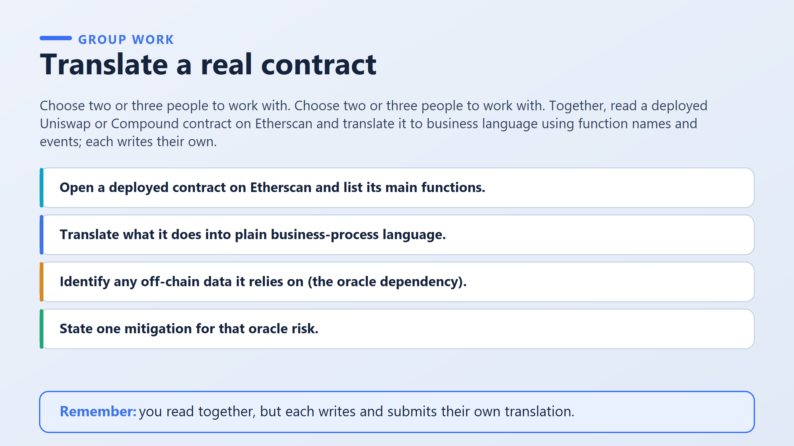

Slide 12
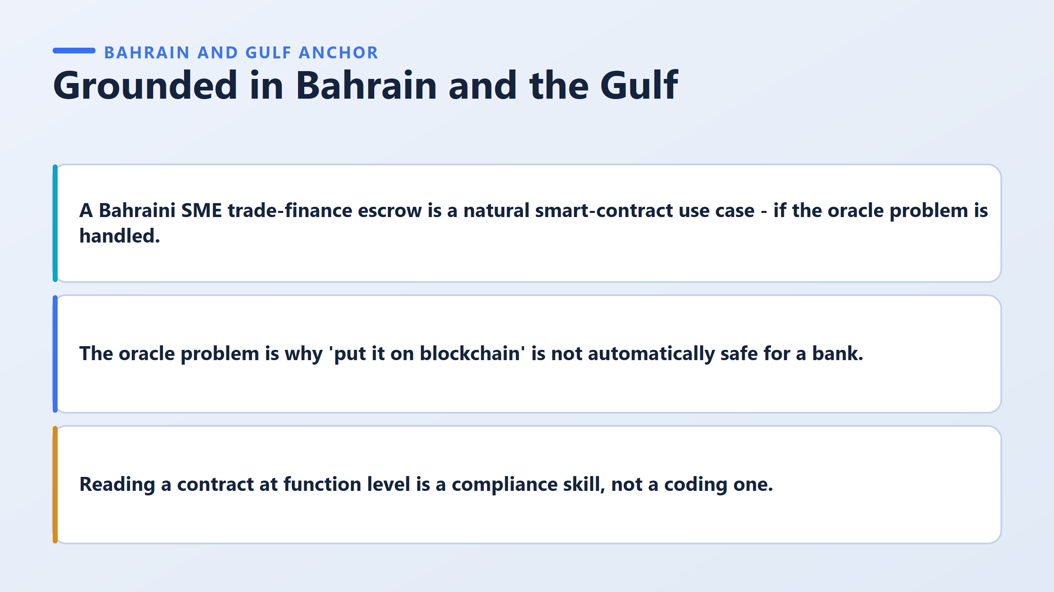

Slide 13
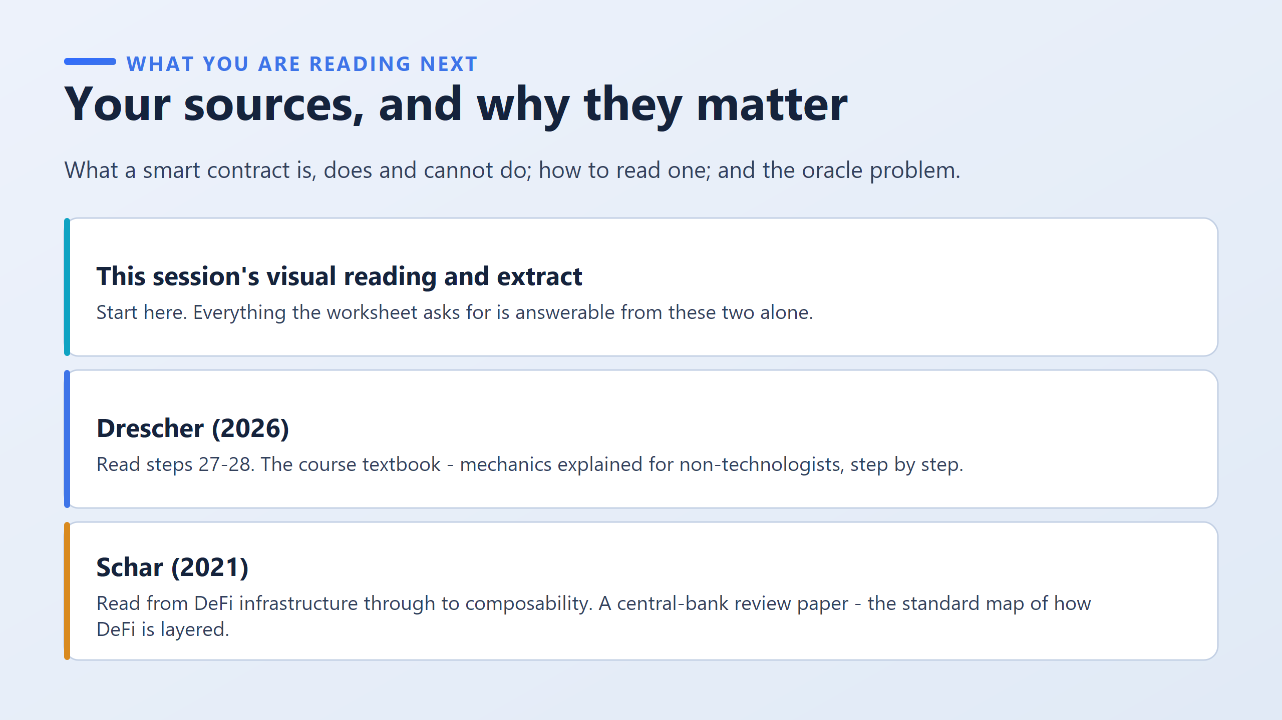

Slide 14
